Slide 1
APE SAVE.com
By Alex Landrov
&
Roshan Thavarajah

Slide 2
WHAT IS APE SAVE?
EBAY clone site
Sellers post items
Buyers shop for items
Buyer pays seller through paypal
Seller ships item

Slide 3
Technologies Used
Php
Twig
JSON
Slim
Htaccess
Paypal
Html & css

Slide 4
Special Features
Users can post their own items
Buyers can bid

Slide 5
Libraries
Twig
One index.php file
Template file

Slide 6
Challenging Items
User session
Login turns to log out in menu when user logs in
Users see different page than non users

Slide 7
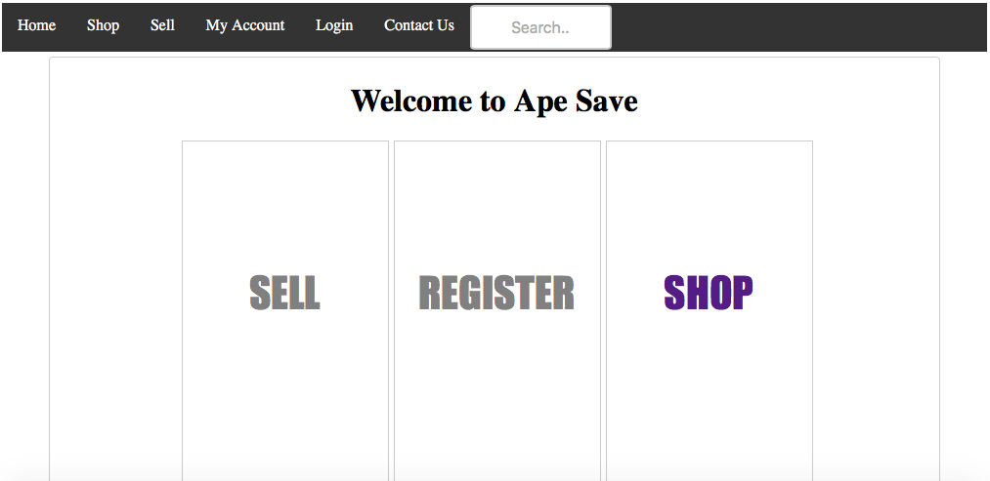
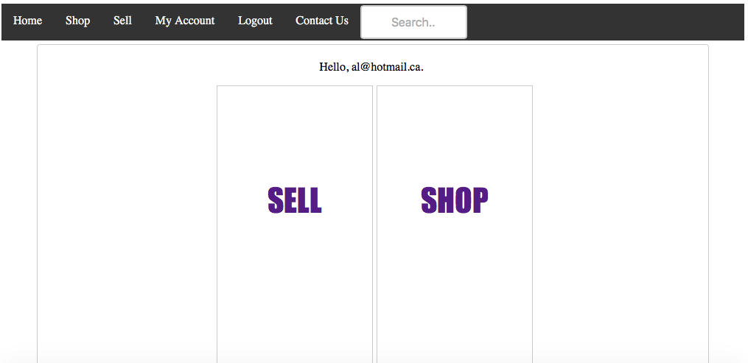
CHALLENGES
pp->get('/index', function() use ($app, $log) {
$app->render('index.html.twig', array('sessionUser' => $_SESSION['user']));
});

Slide 8
Challenging Items
Bidding
Paypal
Getpage by ID
Contact Us

Slide 9
Contact Page Code
$app->get('/contactus', function() use ($app, $log) {
$app->render('contactus.html.twig', array('sessionUser' => $_SESSION['user']));
});
$app->post('/contactus', function() use ($app, $log) {
$email = $app->request->post('email');
$lName = $app->request->post('lName');
$fName = $app->request->post('fName');
$comment = $app->request->post('comment');
$emailus = "ownpurrange3@hotmail.ca";
$html = $app->view()->render('emailus.html.twig', array(
'email' => $email,
'lName' => $lName,
'fName' => $fName,
'comment' => $comment
));
$headers = "MIME-Version: 1.0\r\n";
$headers.= "Content-Type: text/html; charset=UTF-8\r\n";
$headers.= "From: " . htmlentities($fName) . " <" . $email . ">\r\n";
$headers.= "To:<ownpurrange3@hotmail.ca>\r\n";
mail($emailus, "Comment from a user", $html, $headers);
});

Slide 10
HOME PAGE

Slide 11
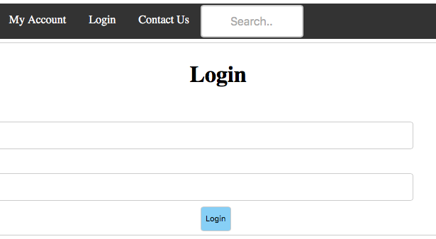
LOGIN PAGE

Slide 12
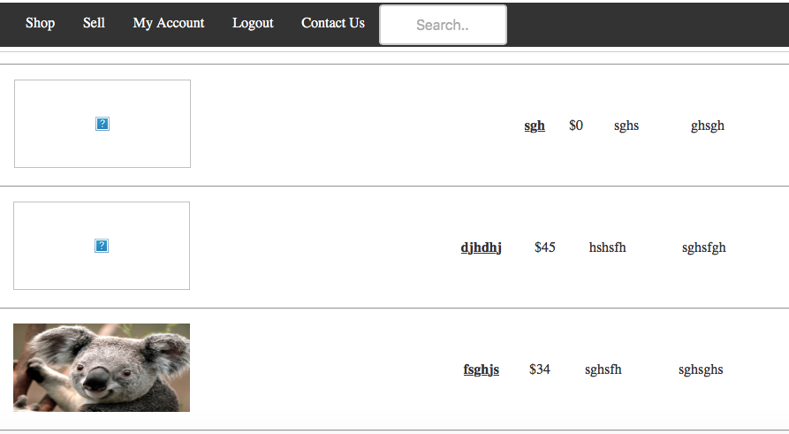
MY ACCOUNT PAGE

Slide 13
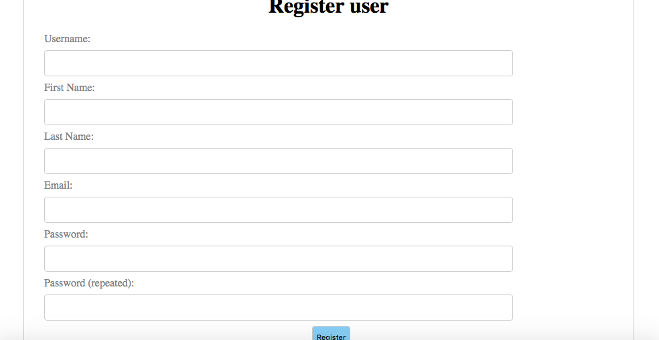
REGISTRATION PAGE

Slide 14
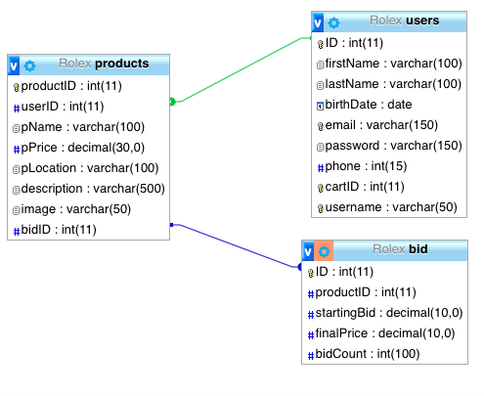
DESIGN OF DATABASE

Slide 15
FUTURE WORK
BID
SELLING FEE
LINKING PAY PAL API
DIFFERENT LANGUAGES
CATEGORY
USER CAN PAY TO BOOST ADS

